Slide 1
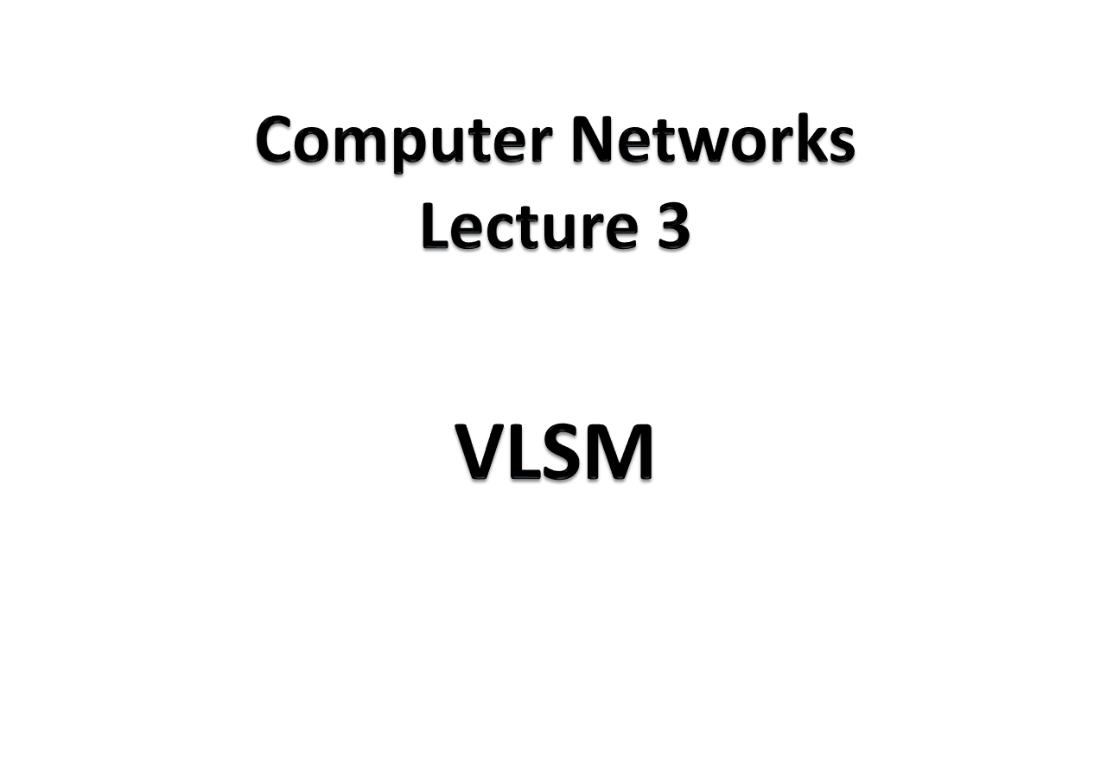

Slide 2
An organization is granted the block 130.34.12.64/26. The organization needs 4 subnets. What is the subnet prefix length?
Solution
We need 4 subnets, which means we need to add two more 1s (log₂ 4 = 2) to the site prefix. The subnet prefix is then /28.
TCP/IP Protocol Suite

Slide 3
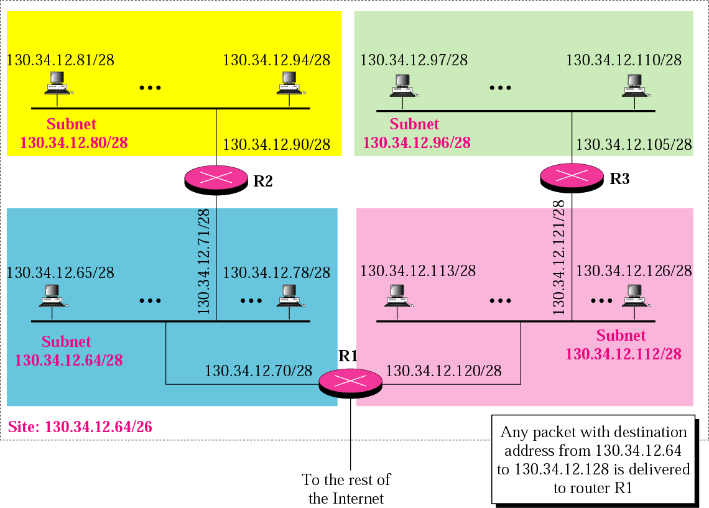

Slide 4
VLSM
Variable Length subnet Masking
The number of devices are nor equal in all the subnets
Prefixes are vary for separate subnets

Slide 5
An organization is granted a block of addresses with the beginning address 14.24.74.0/24. There are 2³²⁻²⁴= 256 addresses in this block. The organization needs to have 11 subnets as shown below:
a. 2 subnets, each with 64 addresses.
b. 2 subnets, each with 32 addresses.
c. 3 subnets, each with 16 addresses.
d. 4 subnets, each with 4 addresses.
Design the subnets.
TCP/IP Protocol Suite

Slide 6
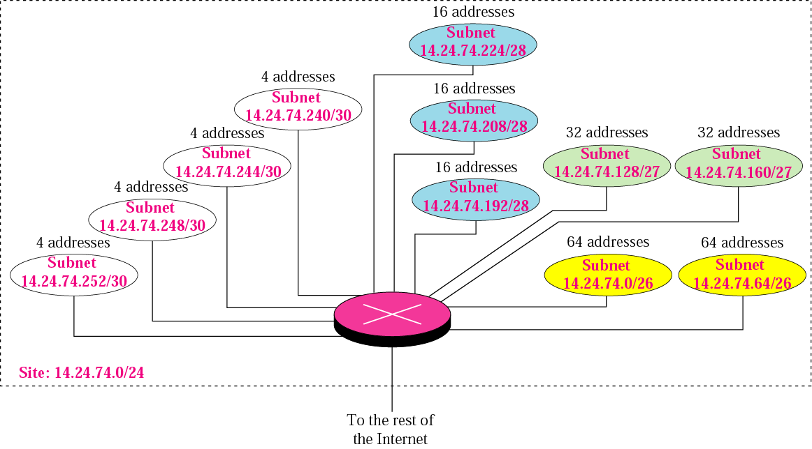
TCP/IP Protocol Suite

